Slide 1
Big Data & Hadoop
Presented by
Mythily Rajavelu M
Decision Science Hadoop (DSH)
04-Aug-2016

Slide 2
Agenda
Big Data Overview
Hadoop Overview
Hadoop Use cases
Hadoop @ BNY Mellon
BNY Mellon Hadoop usage metrics
BNY Mellon Hadoop Use cases

Slide 3


What is Big data?
What is Big Data? And Why Is It Important to anyone?
Is it a product?
Is it a set of tools?
Only big businesses does Big Data?
Isn’t always businesses had big data (Repository)?
What font size is Big Data?
Is it a Volume or Technology?
According to Gartner: Big data is high-volume, high-velocity and high-variety information assets that demand cost-effective, innovative forms of information processing for enhanced insight and decision making
From Wikipedia: Big Data is a broad term for data sets so large or complex that they are difficult to process using traditional data processing applications. Challenges include analysis, capture, curation, search, sharing, storage, transfer, visualization, and information privacy.
My Definition: A Data/ Dataset irrespective of 4Vs, if the business unable to get insight or make decision out of this data using traditional technology and process are called Big data

Slide 4
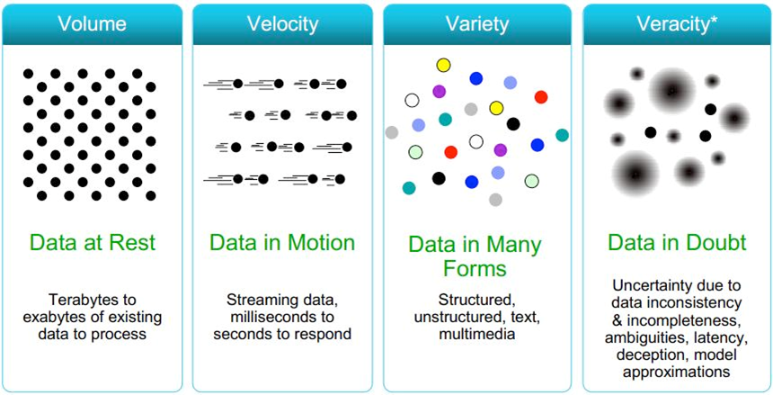
4Vs of Big Data

Slide 5
Hadoop Overview

Slide 6
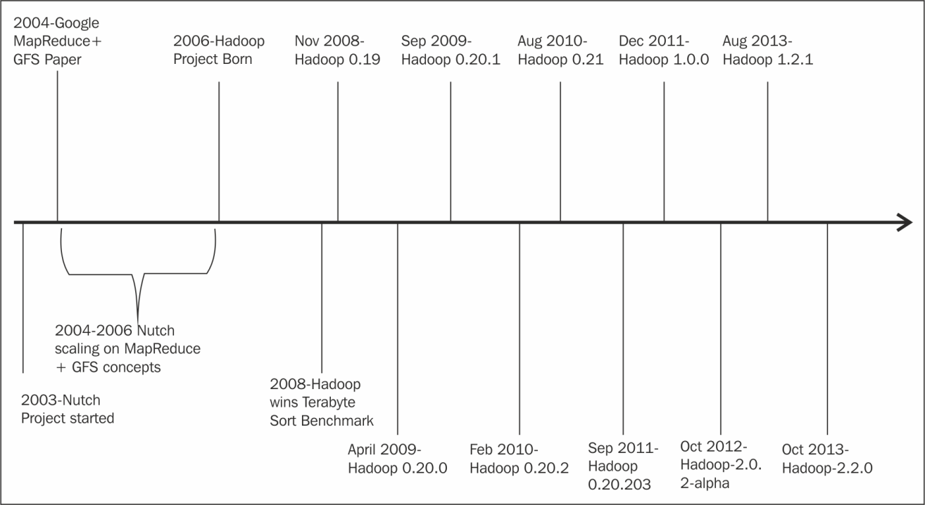
History of Hadoop

Slide 7

Hadoop was inspired by Google's MapReduce
Java-based programming framework
Basically it has 2 things: a Distributed FileSystem (HDFS) + a Computation or Processing framework (MapReduce).
What is Hadoop?
Like any other FS, HDFS also provides storage, but in a fault tolerant with high throughput & lower risk of data loss
Free
Runs applications on systems with thousands of nodes & thousands of terabytes.
Its distributed file system facilitates uninterrupted rapid data transfer rates in case of a node failure.

Slide 8
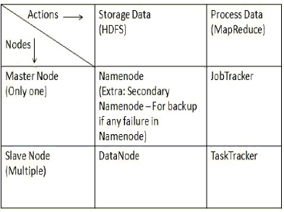
Hadoop Framework
Framework Contains
  Namenode
  Datanode
  TaskTracker
  JobTracker
  Secondary Namenode
Who does What?

Slide 9
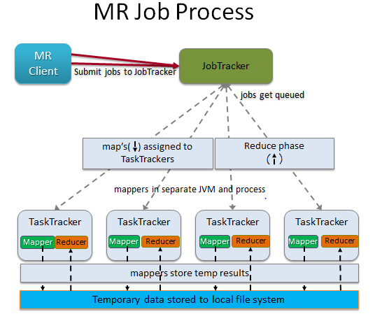
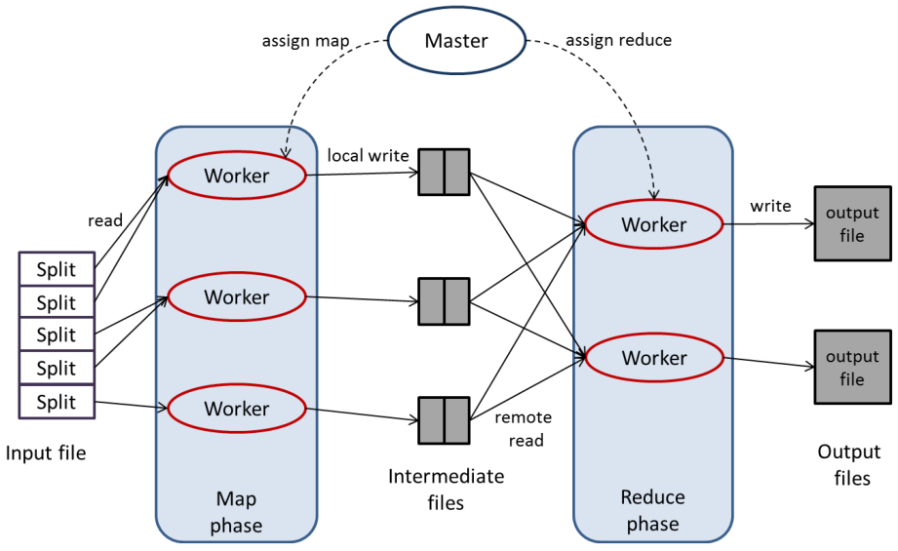
MapReduce
MapReduce is just a computing framework and also called data processing component of Hadoop framework. Purely written in Java.
Used to process large data sets in a batch processing manner
Process layer comprises two phases: Mapper & Reducer
MapReduce is based on key-value pair idea.
Data splits into Key-value pair and processed in divide and conquers method
* Hive and Pig uses MR Framework to process data

Slide 10
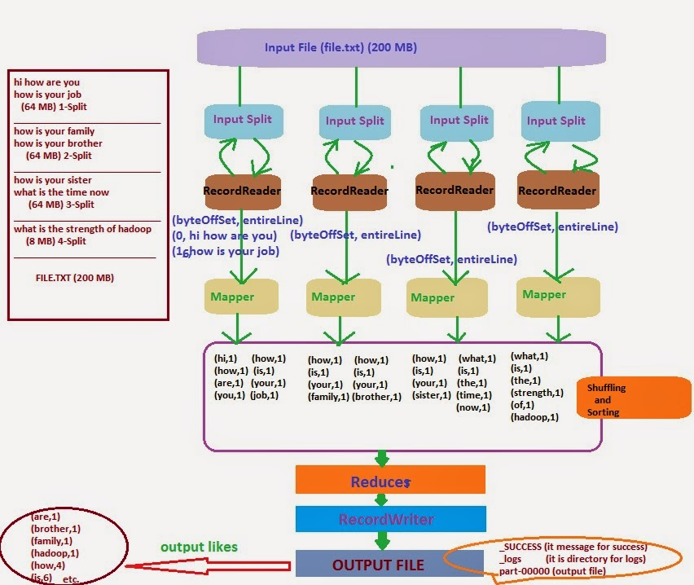
MapReduce – WordCount Example

Slide 11
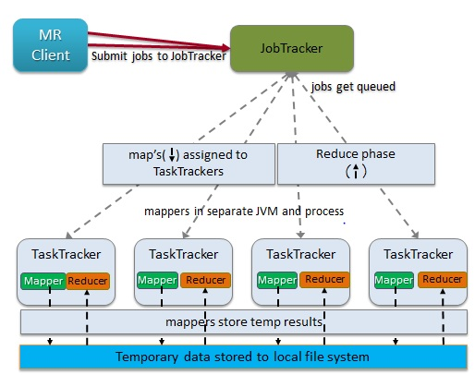
MapReduce – Job Process
1. Client Submits MR Jobs
2 JobTracker receives MR Jobs from Client
2.1 JobTracker assigns JobID and Queued
2.2 Job Scheduler picks the job from Queue
2.3 Job Tracker using Scheduling Algo to determine Job that should be processed first
2.4 Job Tracker assigns task to Task Traker
3 TaskTracker has fixed number of slots
3.1 Copies Jar into local task tracker FS
3.2 Creates local working directory
3.3 Creates instance for TaskRunner
3.4 Sends heartbeat for every 5 Seconds
4 Job Tracker Receives final status from all Taker Tracker
4.1 Combine all Updates
4.2 Update JobID status
4.3 Return Job Status to MR Client
5 Job client receives completed status and Result printed

Slide 12
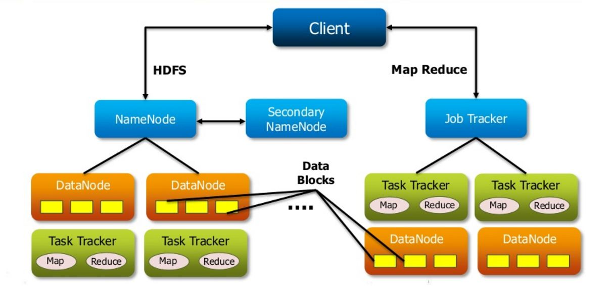
Hadoop 1.0 Arch
Hadoop 1.0, there is tight coupling between Cluster Resource Management and MapReduce programming model
Job Tracker is responsible for both managing the cluster's resources and driving the execution of the MapReduce job in MR Framework

Slide 13
Hadoop 1.0 Challenges
Limits scalability - Single machine doing several task like
  Resource management
  Job and task scheduling and
  Monitoring
NameNode – Single NameNode and Single Namespace, Limited by NameNode RAM
Availability Issue: NameNode is Single Point of Failure. Need Manual Recovery using Secondary NameNode incase of Failure. Also
Job Tracker Overburdended - JobTracker spends significant portion of time and effort in managing application. It is a single Point of availability. Means if JobTracker fails, all jobs must restart
Poor Resource Utilization: Predefined map and reduce slots for each TaskTrackers. Mapper slot will be full and Reducer may be empty
Limitation in running non-MapReduce Application: Job tracker was tightly integrated with MapReduce and only supporting application that obeys MapReduce programming framework, which may lead lack of
  Problem in performing real-time analysis
  Problem in running Message-Passing approach
  Problem in running Ad-hoc query

Slide 14
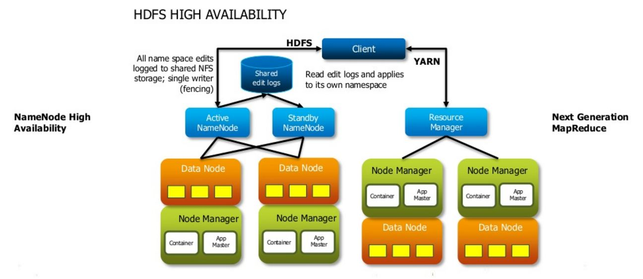
Hadoop 2.0 Arch
YARN forms an Integral part of Hadoop2.0 architecture that enables dynamic resource utilization
Improved cluster utilization
Highly scalable
YARN is backward compatible
JobTracker and TaskTracker disappeared
YARN splits 2 major functionalities of JobTracker i.e. resource management and job scheduling/monitoring into 2 separate daemons (components).
  Resource Manager
  Node Manager(node specific)

Slide 15
Core Components
Categgory | Component | Description
Distributed File System | HDFS | Offers a way to store large files across multiple machines
Distributed Programming | MapReduce | Programming model for processing large data sets with a parallel, distributed algorithm on a cluster
 | Pig | An engine for executing data flows in parallel on Hadoop
 | Spark | A framework for writing fast, distributed programs with a fast in-memory approach
 | Storm | A distributed real-time computation system for processing fast, large streams of data
No-SQL | HBASE | Non-relational distributed database. Ramdom, real-time r/w operations in column-oriented very large tables
SQL-On-Hadoop | Hive | Data summarization, query, and analysis
 | Hcatalog | A relational view of data in the HDFS contains where or in what format your data is stored
 | Drill | For processing large-scale datasets and achieve very high throughput in sub-second latency
 | Phoenix | SQL skin over HBase delivered as a client-embedded JDBC driver targeting low latency queries over HBase data

Slide 16
Core Components
Categgory | Component | Description
Data Ingestion | Flume | A distributed, reliable, and available service for efficiently collecting, aggregating, and moving large amounts of log data
 | Sqoop | System for bulk data transfer between HDFS and structured datastores as RDBMS
 | Kafka | Distributed publish-subscribe system for processing large amounts of streaming data
 | NiFi | A rich, web-based interface for designing, controlling, and monitoring a dataflow
Service Programming | Zookeeper | A coordination service that helps to coordinate the cluster and provide highly-available distributed services.
 | Avro | A framework for modeling, serializing and making Remote Procedure Calls (RPC)
Scheduling | Oozie | Workflow scheduler system
 | Falcon | A data management framework for simplifying data lifecycle management and processing pipelines on Apache Hadoop
Security | Knox Gateway | A single point of secure access for Apache Hadoop clusters
 | Ranger | Central security policy administration across the core enterprise security requirements of authentication, authorization, accounting and data protection
System Deployment | Ambari | Web enabled Hadoop management

Slide 17
Hive & Pig
Pig | Hive
A procedural data flow language | A declarative SQLish Language
Mainly used for Programming | Mainly used for Reporting
Used by researchers and Programmers | Used by Data Analyst
Operates on the client side of any cluster | Operates on Server side of any cluster
Doesn’t have dedicated metadata database and the schemas or data types are defined in the script itself | Makes use of exact variation of the SQL DLL language by defining table beforehand and store metadata
Pig also SQL Like but varies to a great extent. So it needs extra effort to Master | Hive directly leverage SQL Expertise and easy to learn
* Both are using MapReduce Framework

Slide 18
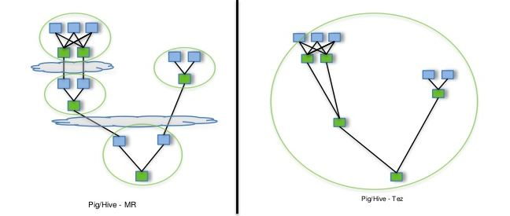
Tez Vs MapReduce
Tez
An extensible framework for building high performance batch and interactive data processing applications.
Tez improves the MapReduce paradigm by dramatically improving its speed, while maintaining MapReduce’s ability to scale to petabytes of data
Built on top of YARN – the resource management framework for Hadoop.
Tez Performance gains over Map Reduce
Eliminate replicated write barrier between successive computations.
Eliminate job launch overhead of workflow jobs.
Eliminate extra stage of map reads in every workflow job.
Eliminate queue and resource contention suffered by workflow jobs that are started after a predecessor job completes.

Slide 19
When to use What?
Depending on type of data to be processed, we have to choose right technology
Few UseCases:
Hive should be used for analytical querying of data collected over a period of time.
  e.g Calculate trends, summarize website logs but it can't be used for real time queries
PIG can be used to construct dataflows, run a scheduled jobs, crunch big volumes of data, aggregate/summarize it and store into relation database systems. Good for ad-hoc analysis
MapReduce: If your problem can not be solved by using SQL straight, try to create UDF for Hive & Pig and then if the UDF is not solving the problem then getting it done via MapReduce
HBase fits for real-time querying of Big Data.
  e.g Facebook use it for messaging and real-time analytics
SQOOP to import structured data from traditional RDBMS database Oracle, SQL Server
FLUME for processing Un-structured data
Real Time Processing
  Storm: Stream Data processing, Rule application
  HBase: Datastore for serving Realtime dashboard
Batch Processing Hadoop
  Frameworks like Pig, MR, Spark, Hive, Shark help in computing. This layer needs scheduler for which Oozie is good option
Event Handling layer
  Kafka serves both Real Time and Batch analytics data flow. Consume high velocity events from sensor

Slide 20
Hadoop Use Cases

Slide 21
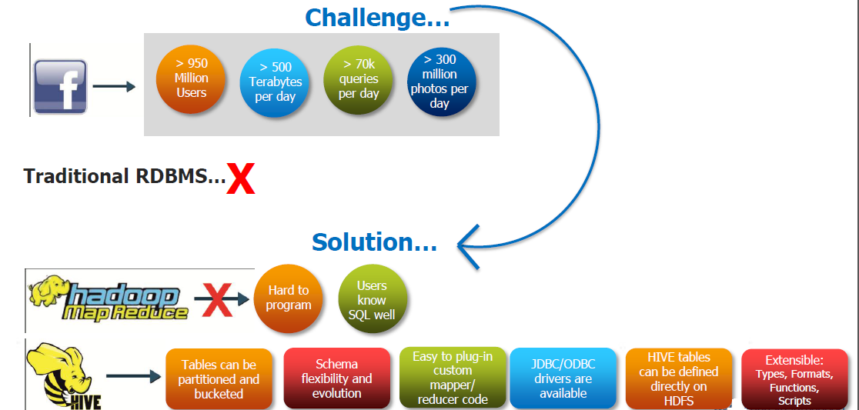
Hive on Facebook

Slide 22

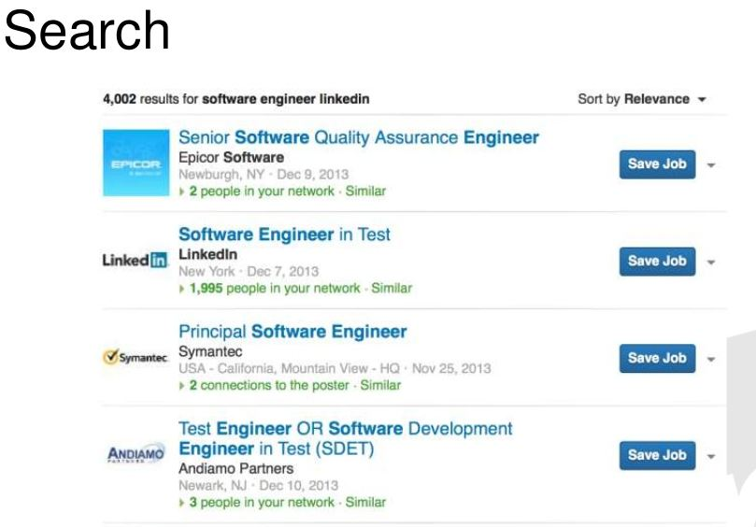
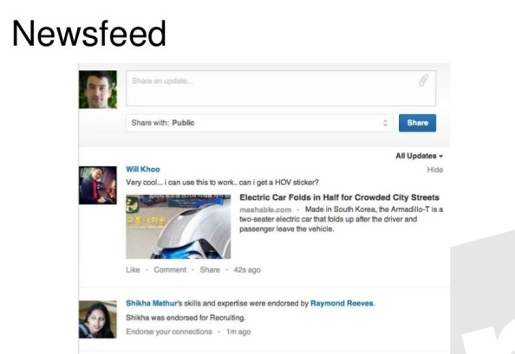
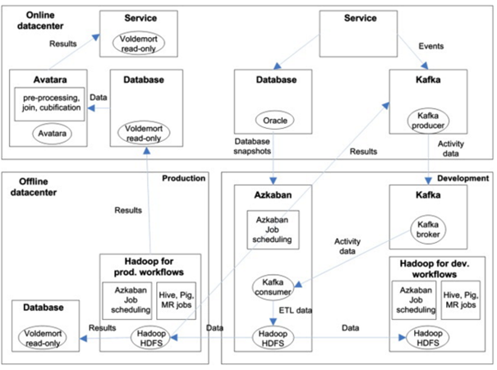
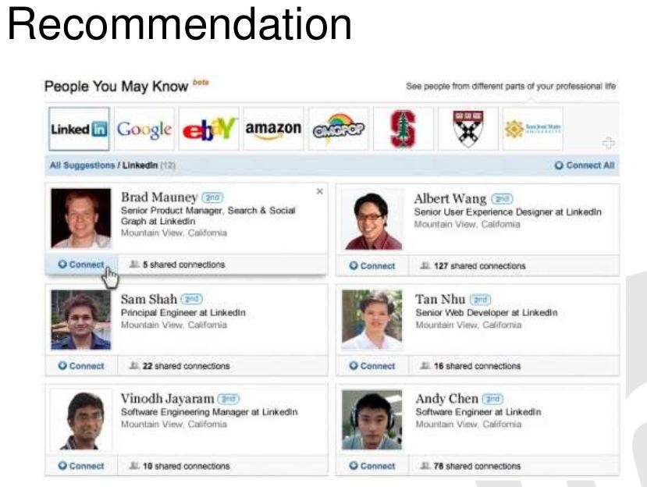
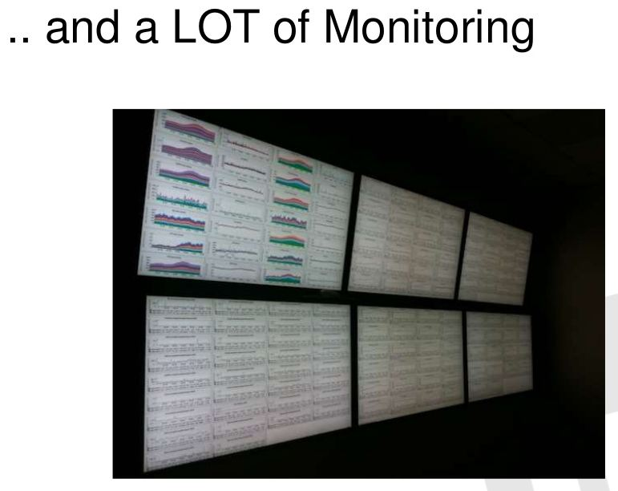
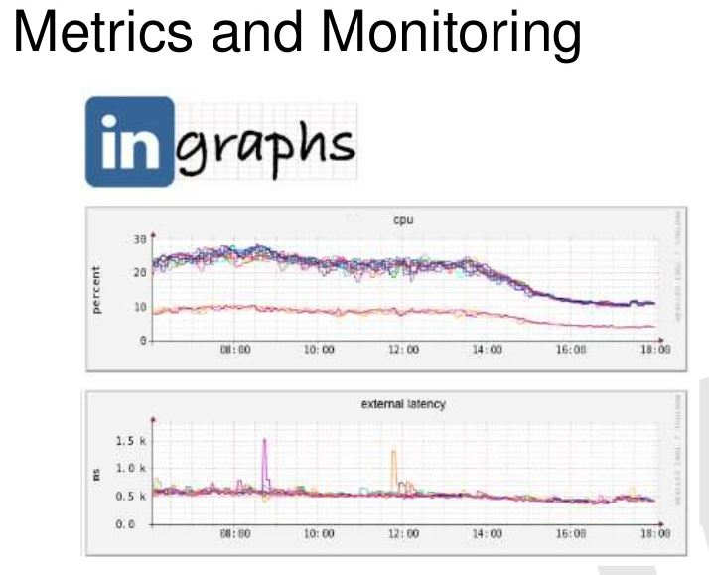
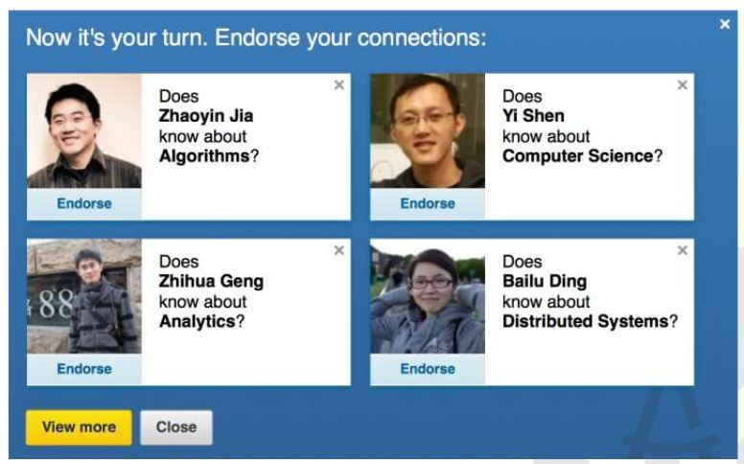
Kafka & Hadoop on LinkedIn
Few Examples
Analysed data pre-processed, and aggregated/cubificated for OLAP
User Activity
OLAP Data
Database Snapshot
an offline debugging database
All user Event into Hadoop ETL - Combining, Transforming & Deduplication

Slide 23
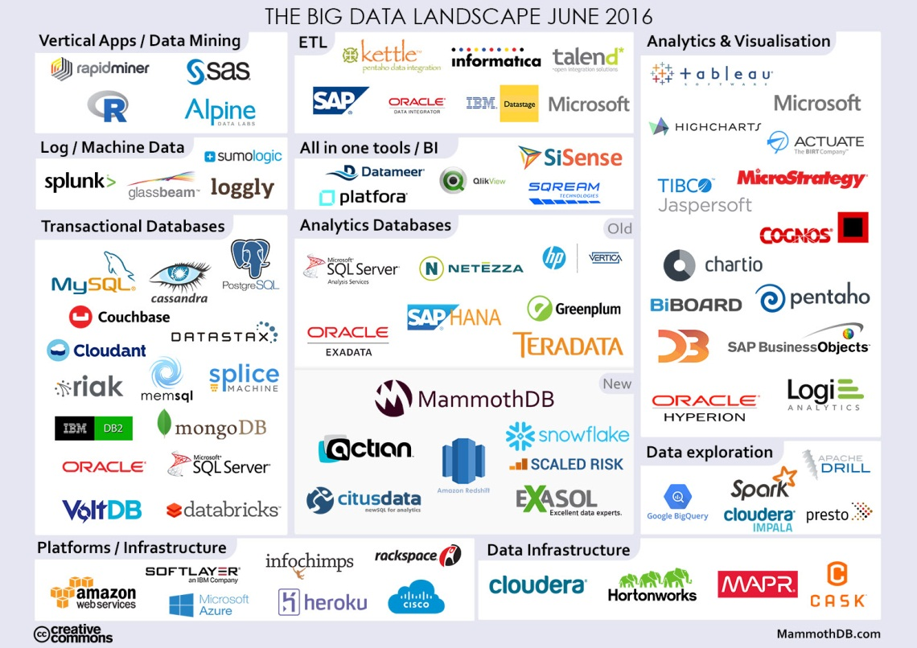
Big Data Solution Providers

Slide 24
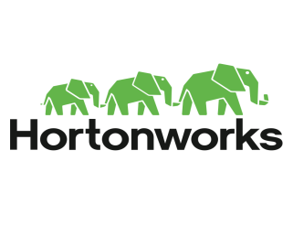
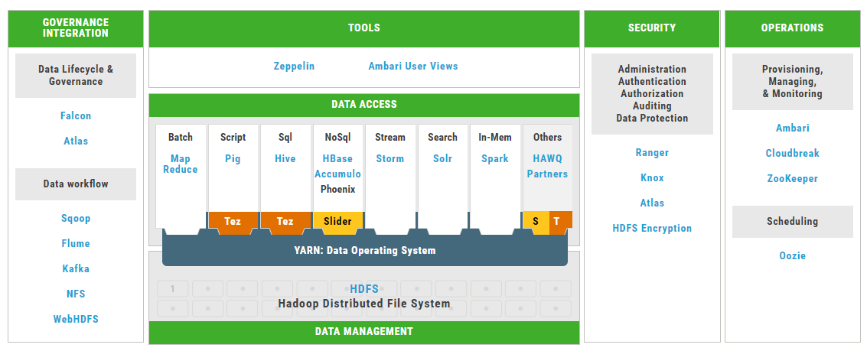
Hadoop @ BNY Mellon
BNY Mellon has Hotronwork Distribution and current version is HDP2.4.2
In total 72 nodes in 2 Data centers comprises 4 regions
Each node contain 256 GB RAM and 32 core CPU
Service nodes of size 2 TB and Data nodes of size 12 TB (In total data node size is close to about `400TB)
Kerberos Authenticated
4 node Kafka in each data center

Slide 25
Hadoop Usage Metrics

Slide 26
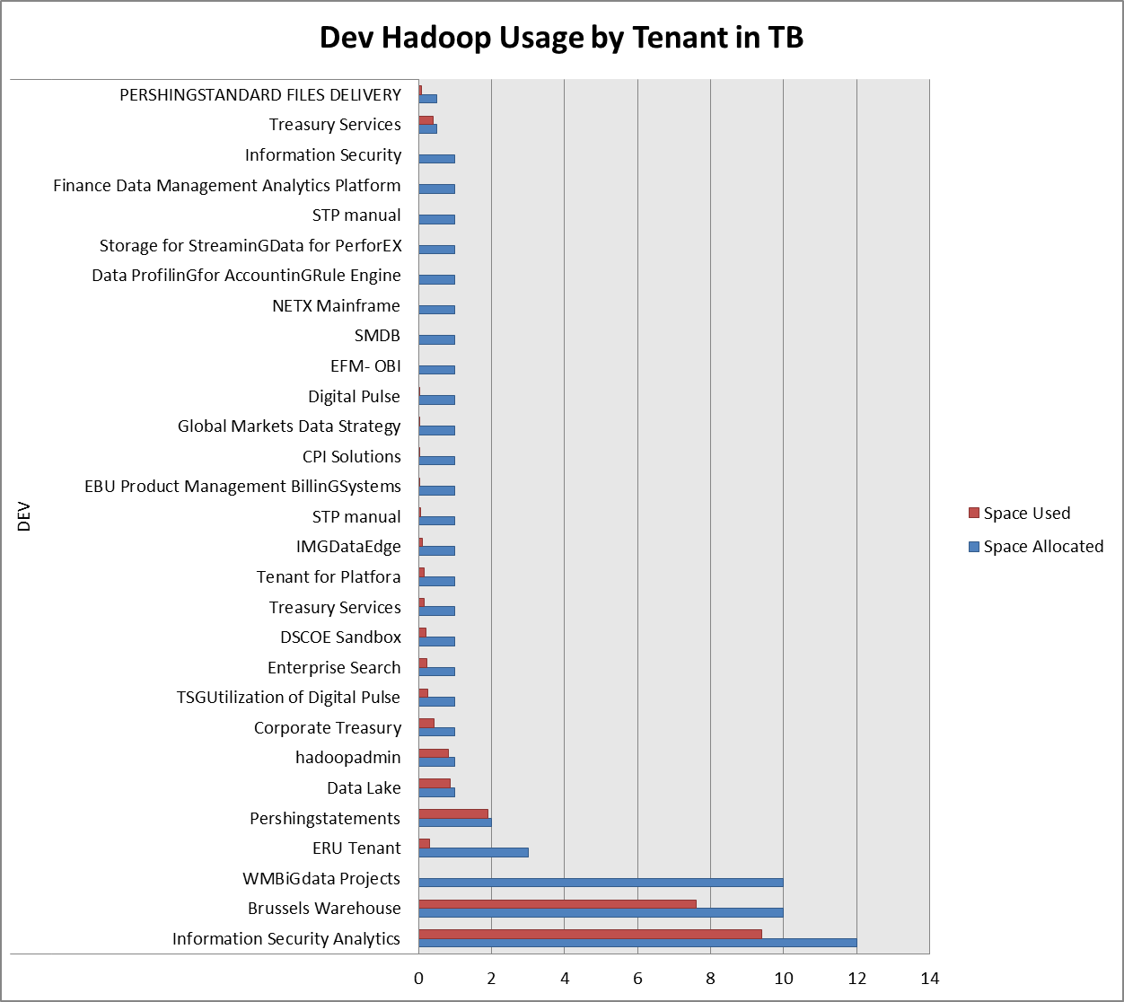
Hadoop Usage metrics
Others Tenant with minimal usage
Pentaho Data Integration Hadoop Tenant
Asset ServicinG(GPX)
DWP HADOOP TENANT
Splunk Hadoop instance
OSA FIRCOSOFT
Data Exploration and Pattern Discovery in TSGInfrastructure Data
Splunk As a Shared service
NEXEN Data Servives;
GBS Technology Services
Semantic Technologies and Data Architecture
Project Greenfield
DP Capture
EFM074-EFMData Lake
MUR075-Murex Market Risk: MarketData
CIW076-Report Generation
RTS data
CNY Analytics
eAnalytics
Enterprise Data Services
Application Developer Team
eAnalytics Hadoop tenanat
UCITSV
FXH QTGDevelopers
BKU Metric

Slide 27
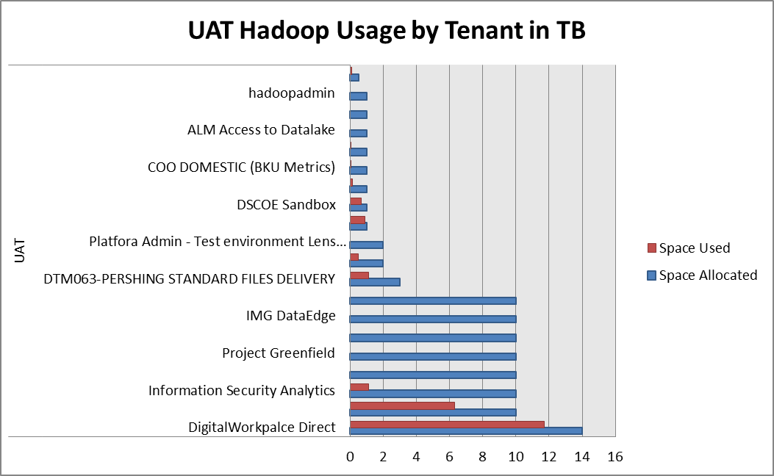
Hadoop Usage metrics

Slide 28
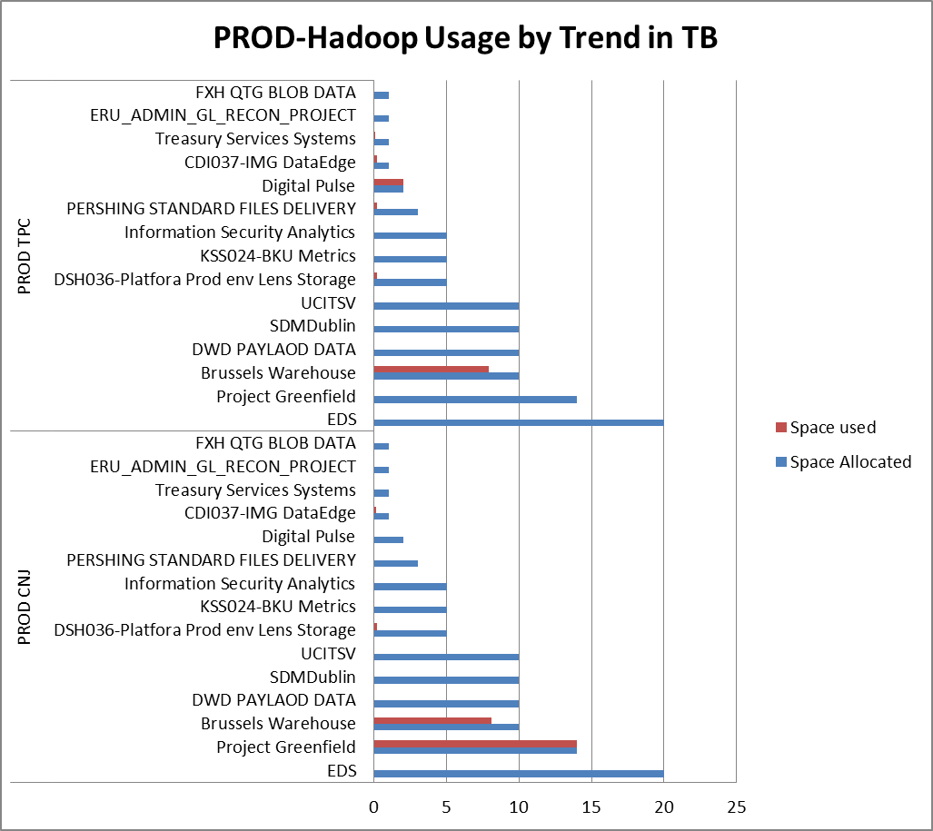
Hadoop Usage metrics

Slide 29
Major Components Used @ BNY Mellon
Management & Monitoring Services
(Ambari, Zookeeper)
Workflow & Scheduling
(Kafka, Oozie)
Non-Relational Database
(Hbasse)
Data Processing
(Pig)
Query
(Hive)
Data Integration Services
(Hcatalog, APIs, WebHDFS, Sqoop, FLume)
Metadatga Services
(HCatalog)
Distributed Processing
(MapReduce)
Data Access
(Storm,Spark,Hue )
Distributed Storage
(HDFS)

Slide 30
More Details on our Hadoop
MSS Page:
https://mysourcesocial.bnymellon.net/groups/big-data
Hadoop Onboarding:
https://mysourcesocial.bnymellon.net/docs/DOC-17261
Hadoop JIRA Account:
http://bnymjira.bnymellon.net/jira/browse/EDSADSHSUP
Hadoop Metrics: http://r37cn00.bnymellon.net:3838/BNYM_apps/hdp_dashboard1/
Mail ID: hadoopadmin@bnymellon.com

Slide 31
Thank you

Slide 32
BNY Mellon
Hadoop Use case

Slide 33
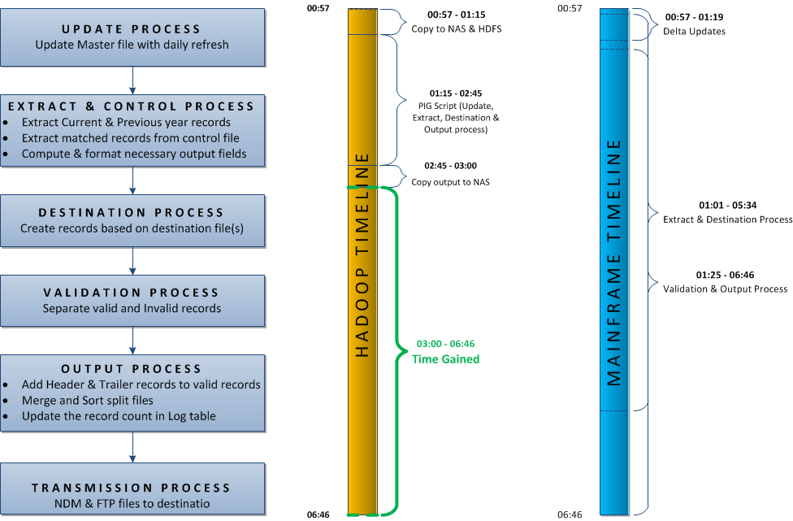
Volume - Data Processing
Processing times (Hadoop Vs Mainframe) - Pershing Statement – M/F

Slide 34
Benefits of Moving into Hadoop
Processing times (Hadoop Vs Mainframe) - Pershing Statement – M/F
Mainframe Process into Hadoop
Reduced Peak hours load;
MIPS Cost saving (for about $2.7 Million charge back)
Meet SLAs
Easy Accessible
Better scalability: handle higher volume at lower cost; capacity can be easily added
Hadoop can emerge as an alternate batch processing platform
    Existing ‘low-complex + high-volume + peak-hour’ batch processes can be moved to Hadoop
Notes:
Add any final notes you think will assist in understanding the recommendations here

Slide 35
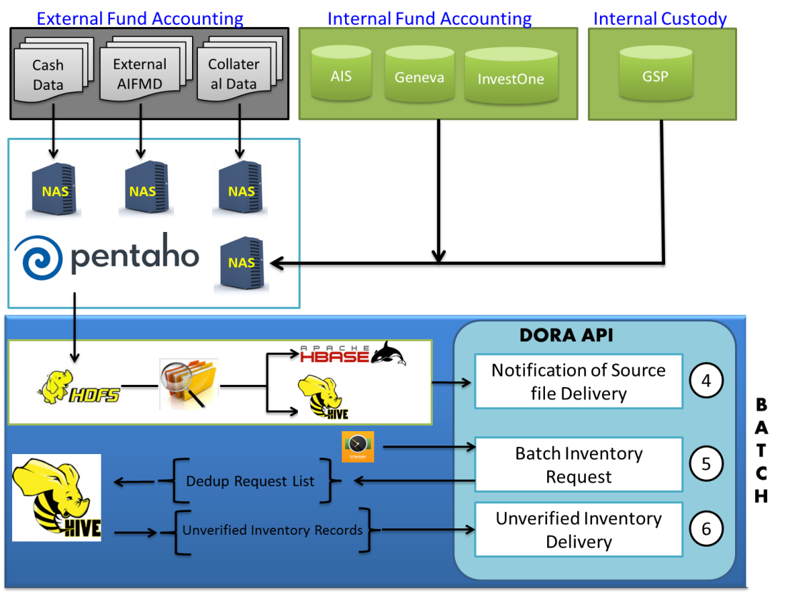
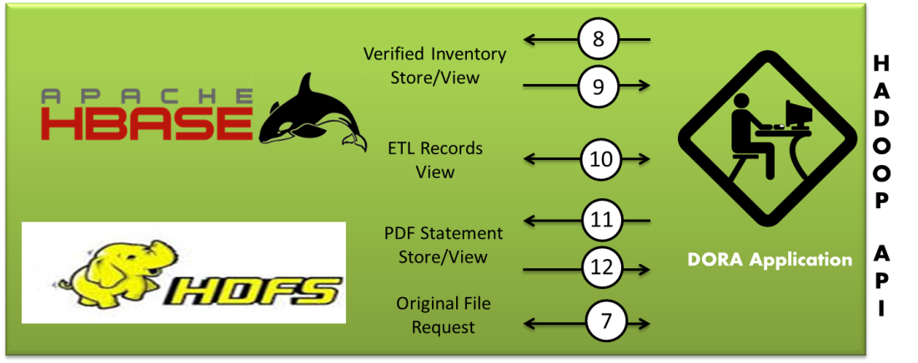
Data as a Service
Data Processing
Data on Call
Data Load on Call
Data Retrieval on Call
Data Search on Call

Slide 36
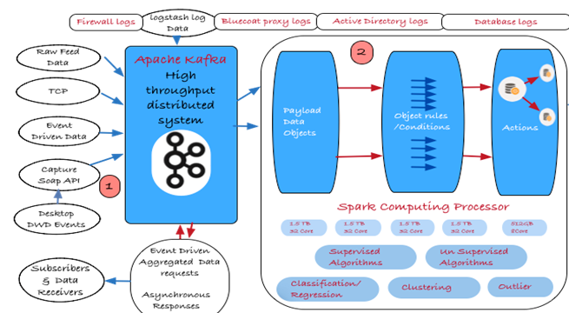
Velocity

